Slide 1

Using the CSS BOX MODEL
Presented By: Jeremy Diamond
Presented Date: 1/24/2022

Slide 2
What is the CSS Box Model?
The CSS box model is the box that wraps around every HTML element. It consists of: margins, borders, padding, and the actual content.

Slide 3
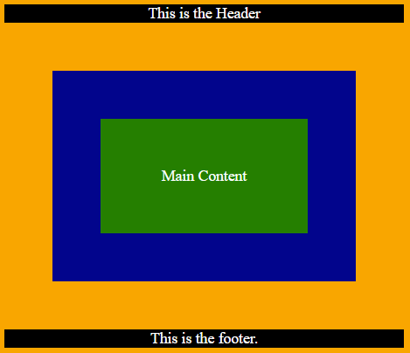
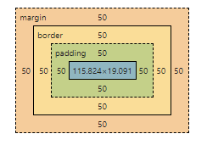
What exactly does that mean?
Web Page in Inspector
Web Page Example
Margin
Border
Padding
Padding
Border
Margin

Slide 4
Why is it important to know?
If we do not understand what each part of the CSS Box Model does, we will not be able to get things to look exactly how we need them to.
We need to understand it so we know how much room each box will take up on our page.

Slide 5
Understanding the Math
It is important to understand that in order to set the width and height of an element with css, all you need to do is set the content area. To do this you will use the following formulas.
content width = left margin + left border + left padding + object width +
right margin + right border + right padding
content height = top margin + top border + top padding + object height +
bottom margin + bottom border + bottom padding

Slide 6
Practice
Lets take a closer look at the sample site on slide 3.

